Slide 1


Cryptocurrency Price Prediction Using Learning Algorithms
BCSE498J - Project - II
RISHAV SRIVASTAV (21BKT0088)
SHUBHAM GUPTA (21BKT0097)
BHAKHAR TEJ MAGANBHAI (21BCE3374)
Under the guidance of Professor Niha K.

Slide 2
Literature Survey
REFERENCE PAPERS:
Chen, X., & Zhao, Y. (2021). Cryptocurrency Price Prediction Using LSTM with Technical Indicators. Journal of Financial Data Science, 4(2), 56-72.
Hiransha, M., et al. (2018). NSE Stock Market Prediction Using LSTM. Applied Intelligence, 48(12), 4727-4742.
Kou, G., et al. (2022). Hybrid Machine Learning Approaches for Cryptocurrency Forecasting. Expert Systems with Applications, 203, 117345.
Gap Identification
Limited Exploration of Alternative Machine Learning Techniques:
Limited Generalization Across Different
Cryptocurrencies:
The study primarily focuses on Long Short-Term Memory (LSTM) networks combined with technical indicators for cryptocurrency price prediction. It does not explore other advanced machine learning models such as Reinforcement Learning (RL), Generative Adversarial Networks (GANs), or Transformers, which could offer different perspectives and potentially improved performance in capturing complex market dynamics.
While the model may achieve predictive success, the study does not address the interpretability of the LSTM model's decisions. Implementing Explainable AI techniques like SHAP (Shapley Additive Explanations) or LIME (Local Interpretable Model-Agnostic Explanations) could enhance understanding and trust in the model's predictions.

Slide 3
Gap Identification
NSE Stock Market Prediction Using LSTM. (2018)
Challenges in Multi-Timeframe Analysis:
Handling Extreme Market Volatility:
The research focuses on predicting stock prices using LSTM models but does not address the analysis across multiple timeframes. Incorporating multi-timeframe analysis could provide a more comprehensive understanding of market trends and improve prediction accuracy.
The study does not specifically tackle the issue of sudden market crashes or spikes, which are common in stock markets. Developing models that can adapt to high volatility and unexpected market movements remains an open research area.
Hybrid Machine Learning Approaches for Cryptocurrency Forecasting. (2022)
Scalability and Real-Time Forecasting Challenges:
Lack of Explainable :Implementation Centralized systems rely on a single authority for data management.
While the study explores hybrid machine learning models for cryptocurrency forecasting, it does not address the implementation of these models in real-time trading environments. Research into low-latency, high-speed models capable of continuous learning and real-time predictions is necessary for practical trading applications.
The paper may focus on a select few cryptocurrencies, potentially limiting the generalizability of the proposed models. Expanding research to include a diverse range of cryptocurrencies could enhance the robustness and applicability of the forecasting models.

Slide 4

Problem Formulation
Cryptocurrency markets are characterized by extreme volatility, non-linear price movements, and rapid fluctuations influenced by various factors such as public sentiment, global news, and speculative trading. Traditional financial models often fail to accurately predict price trends in such dynamic and unpredictable environments due to their inability to capture complex patterns and adapt to changing conditions.
Despite the increasing application of machine learning and deep learning techniques for financial forecasting, challenges remain in identifying the most effective models for cryptocurrency price prediction. These include issues like overfitting, poor model interpretability, limited generalization across different cryptocurrencies, and inadequate handling of market anomalies and manipulation.

Slide 5
Objectives of the Proposed System
Develop Predictive Models for Cryptocurrency Prices
Implement LSTM, XGBoost, and Random Forest models to forecast cryptocurrency prices and compare their performance.
Integrate Technical Indicators for Feature Engineering
Use EMA, RSI, MACD, and Bollinger Bands as features to improve model input quality.
Assess Feature Combinations
Analyze the impact of various technical indicator combinations on model performance.
Address Data Preprocessing and Quality Issues
Handle missing values, outliers, and normalize data to maintain data integrity.
Metrices for Model Evaluation
Evaluate models using MAE, RMSE, and R-squared metrics to measure prediction accuracy.
Traditional vs. Deep Learning Approaches
Compare traditional machine learning models with deep learning architectures to identify the best performer.

Slide 6
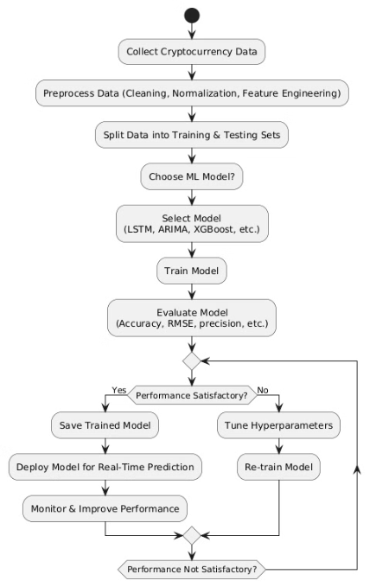
System Design
Step 1: Collect Data
Gather historical cryptocurrency price data from relevant sources (APIs, exchanges, etc.).
Step 2: Preprocess Data
Clean missing values and remove anomalies.
Normalize data for better model performance.
Perform feature engineering (e.g., moving averages, technical indicators).
Step 3: Split Data
Divide the dataset into training and testing sets (e.g., 80-20 split).
Step 4: Choose ML Model
Decide whether to use deep learning (LSTM), statistical models (ARIMA),
or ensemble methods (XGBoost).
Step 5: Train Model
Fit the selected model on training data.
Step 6: Evaluate Model
Measure performance using metrics like Accuracy, RMSE, and Precision.
Step 7: Performance Check
If performance is satisfactory, proceed to Step 8.
If not satisfactory, tune hyperparameters and retrain the model, then return to Step 6.
Step 8: Save Trained Model
Store the trained model for future use.
Step 9: Deploy Model for Real-Time Prediction
Implement the model in a production environment for live cryptocurrency price predictions.
Step 10: Monitor & Improve Performance
Continuously track model performance and make improvements as needed.
If model performance drops, repeat Steps 6-7.

Slide 7
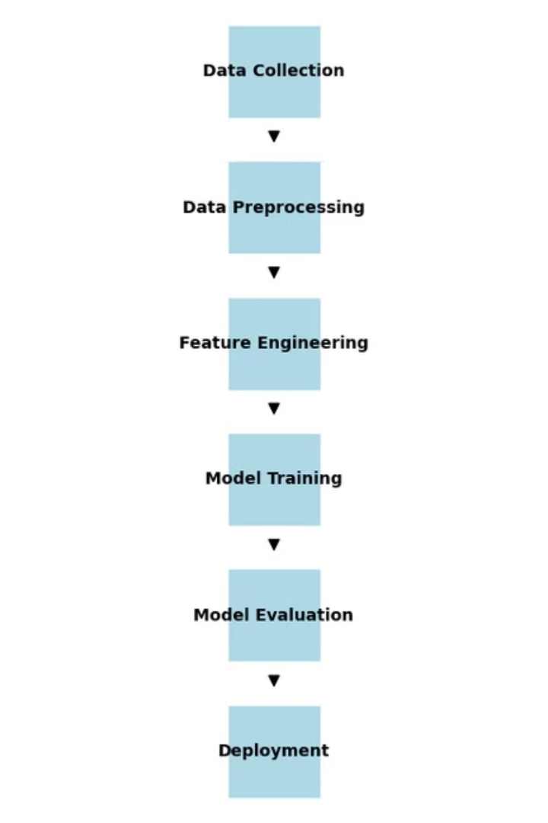






Proposed Solution
Data Collection & Preprocessing Module
Collect and preprocess historical cryptocurrency price data.
Feature Engineering & Selection Module
Identify and select the most important features that influence cryptocurrency price movements.
Model Selection & Training Module
Train and optimize machine learning models for price prediction.
Model Evaluation & Performance Analysis Module
Assess model performance using statistical metrics.
Real-Time Prediction & Deployment Module
Deploy the trained model for real-time predictions.
Result Interpretation & Decision Support Module
Provide insights and recommendations based on model predictions.

Slide 8


Software and Hardware Requirements
Software
Hardware
Operating System: Windows 10/11, macOS, or Linux (Ubuntu recommended)
Processor : Intel i5 processor
Programming Language: Python 3.x
Memory (RAM) : 8 GB
Development Environment: Jupyter Notebook or any IDE like VS Code or PyCharm
Storage : 256 GB SSD
Libraries and Packages: Pandas, NumPy, Matplotlib, Seaborn, Scikit-learn, TensorFlow, Keras, or PyTorch
Graphics Processing Unit (GPU)
Deployment Platform: Docker (Optional for containerization) or Cloud services like AWS/GCP/Azure for real-time predictions

Slide 9
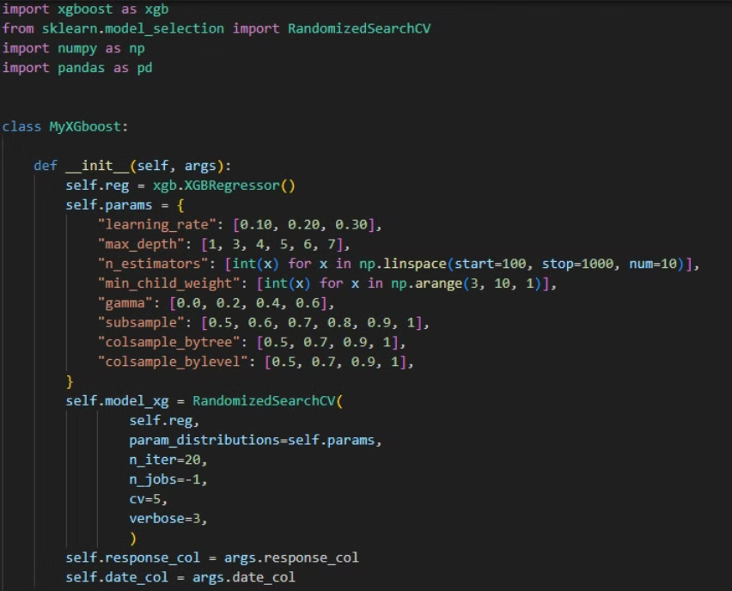
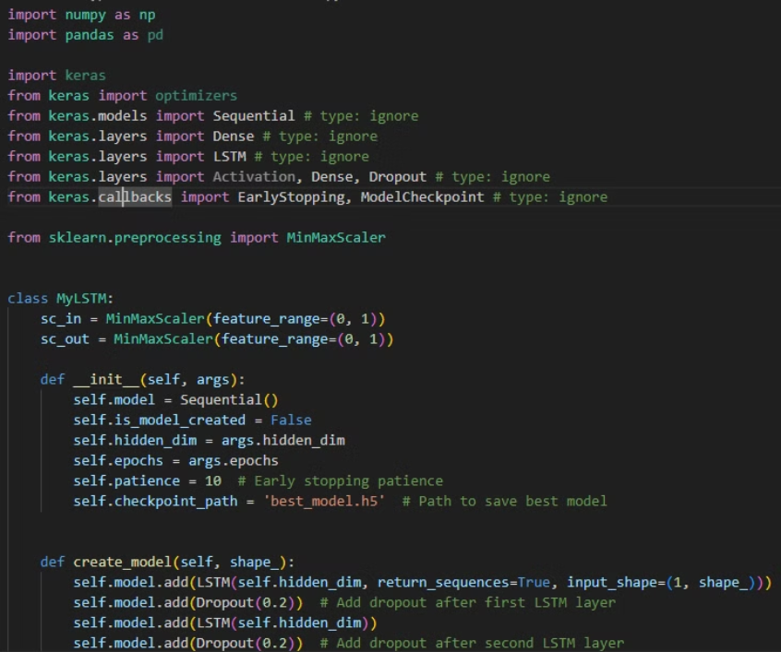
Implementation
CODES FOR XGBOOST & LSTM
XGBOOST
LSTM

Slide 10
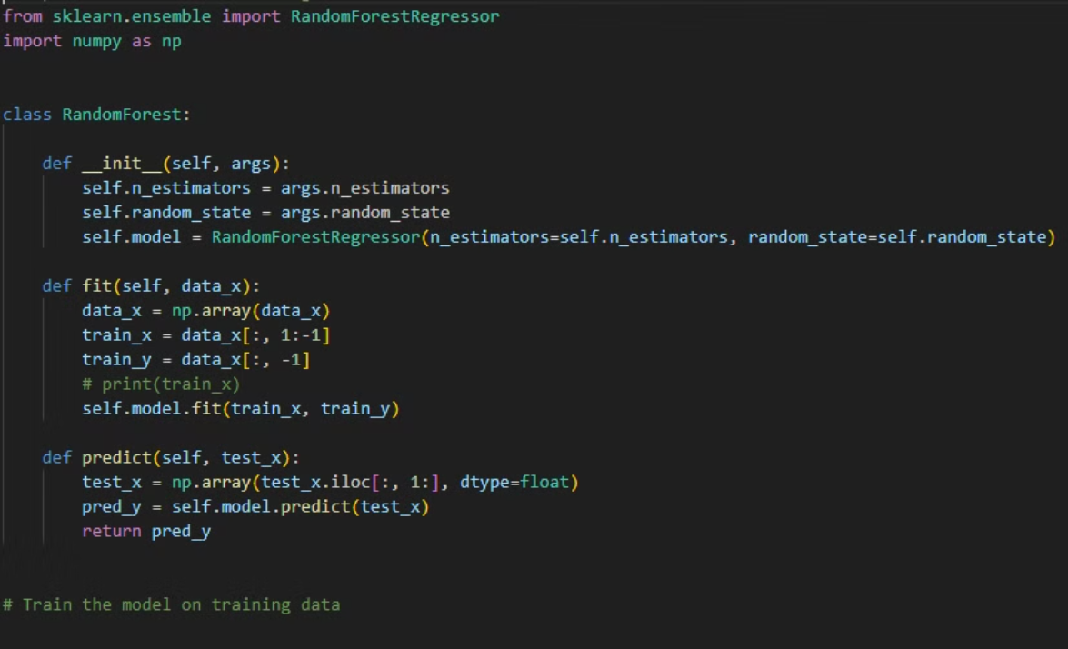
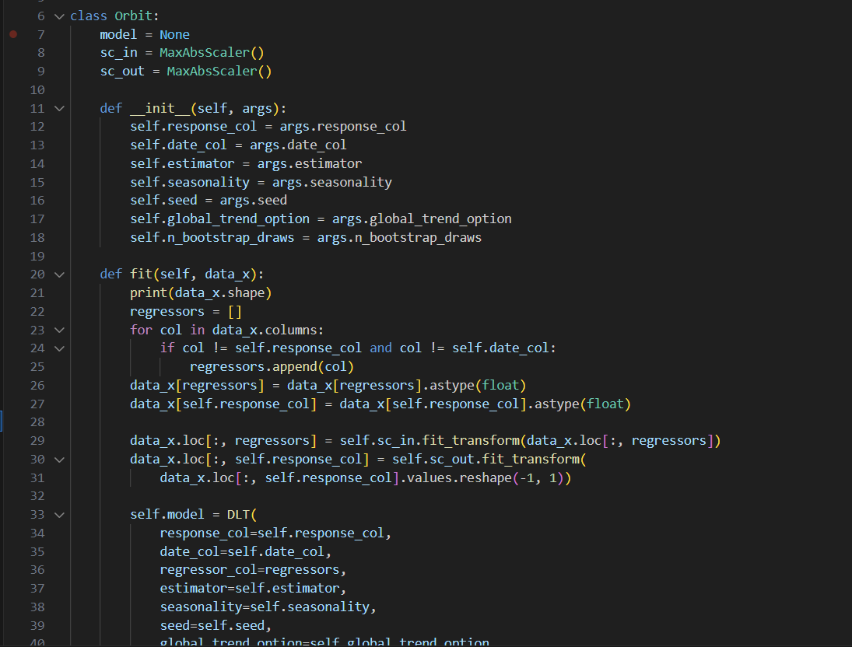
Implementation
RANDOM FOREST
ORBIT-ML

Slide 11
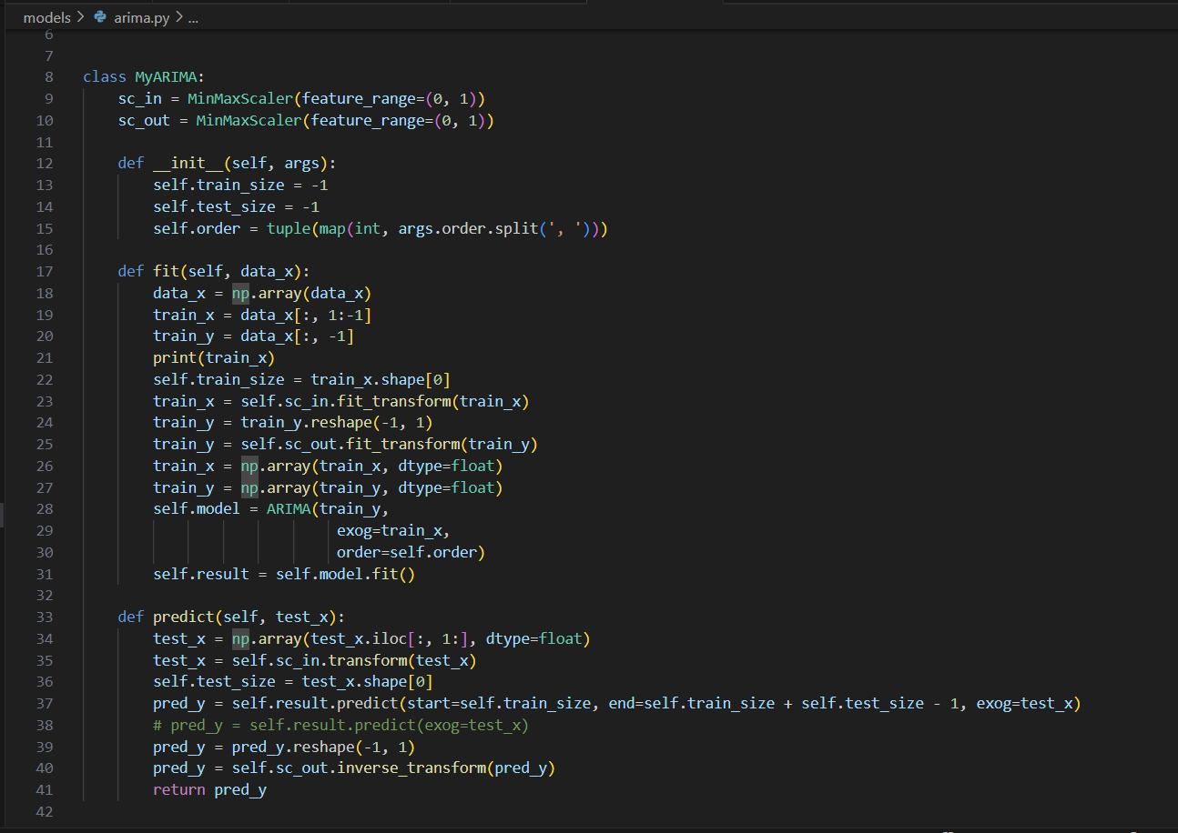
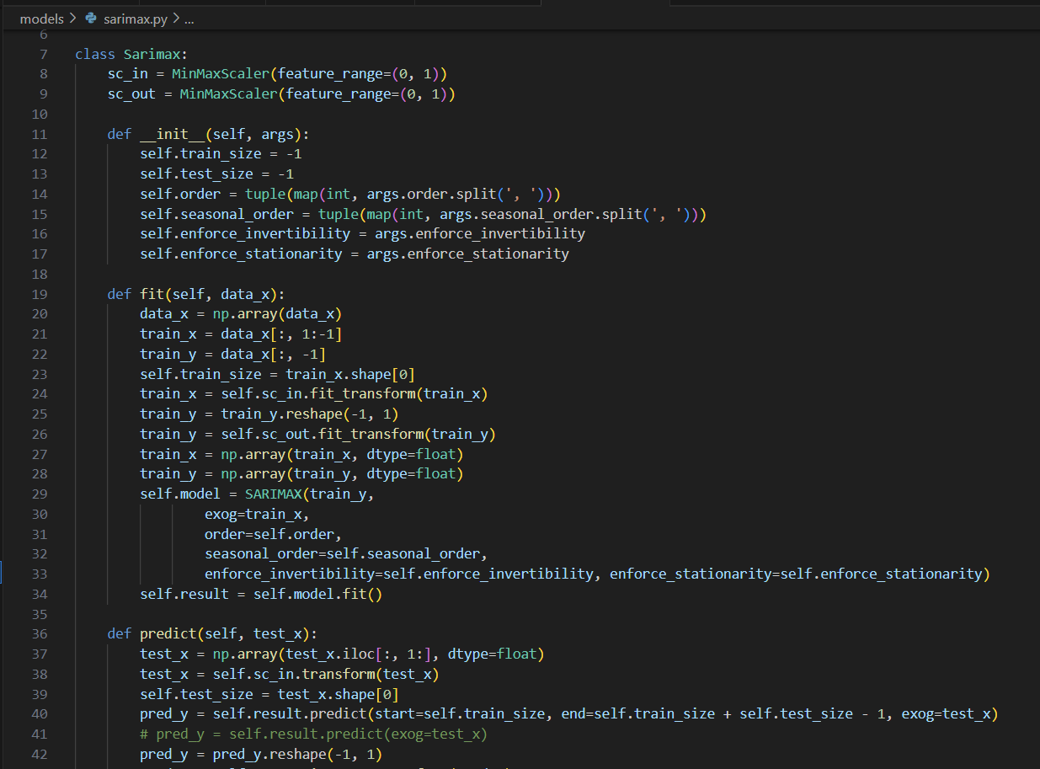
Implementation
ARIMA
SARIMAX

Slide 12
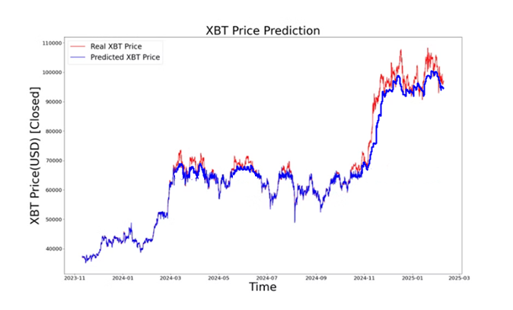
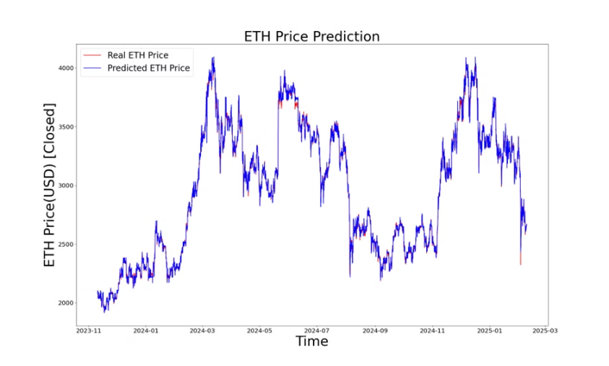
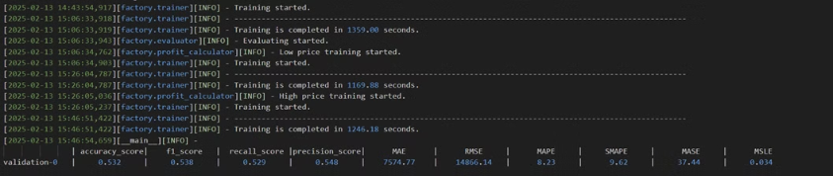
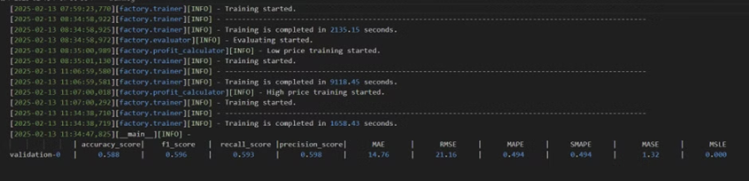
OUTPUT XGBOOST
BITCOIN
ETHEREUM

Slide 13
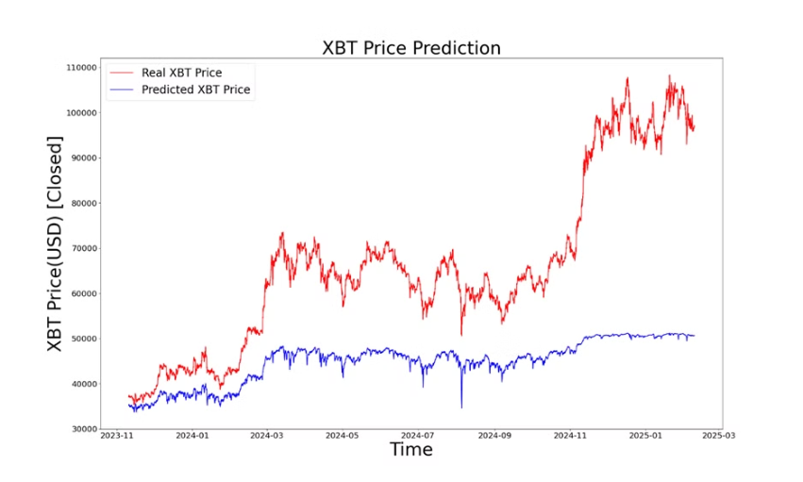
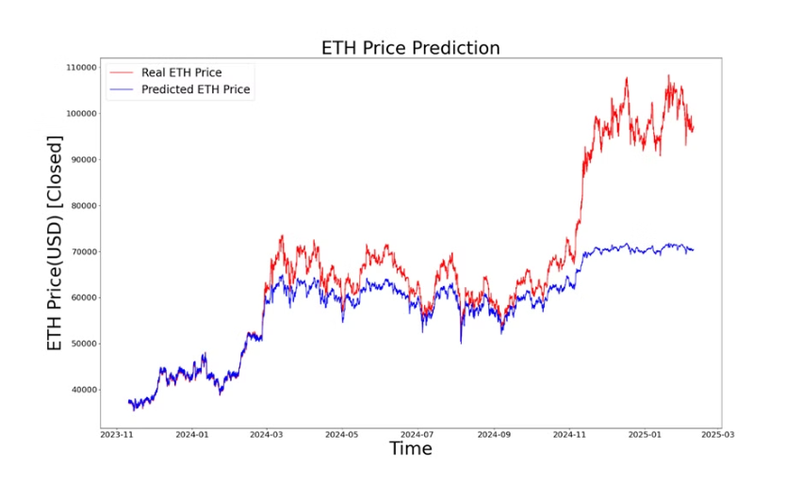
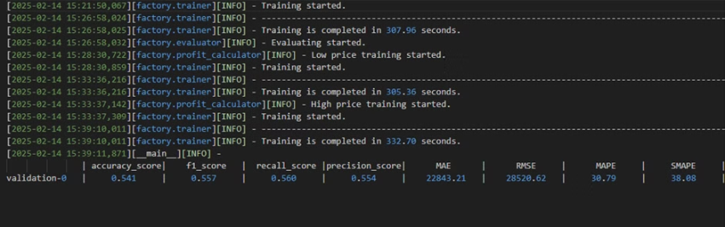
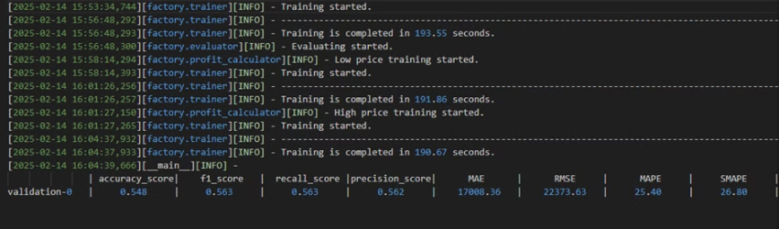
OUTPUT LSTM
BITCOIN
ETHEREUM

Slide 14
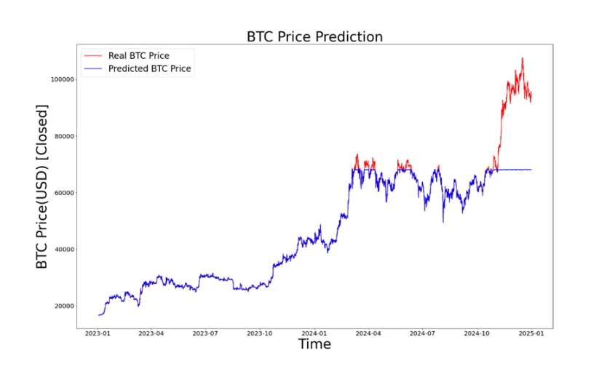
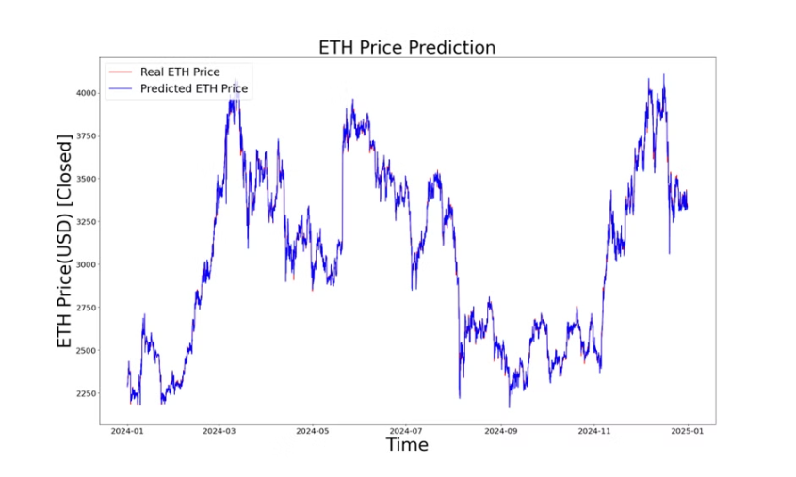
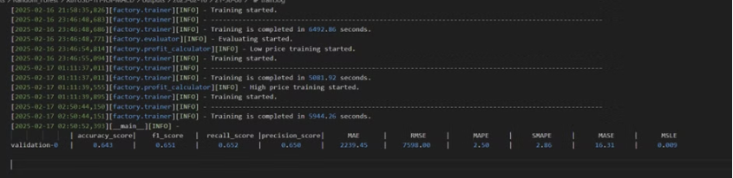
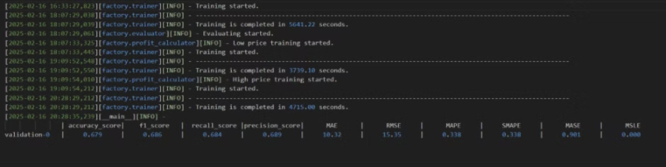
OUTPUT RANDOM FOREST
BITCOIN
ETHEREUM

Slide 15
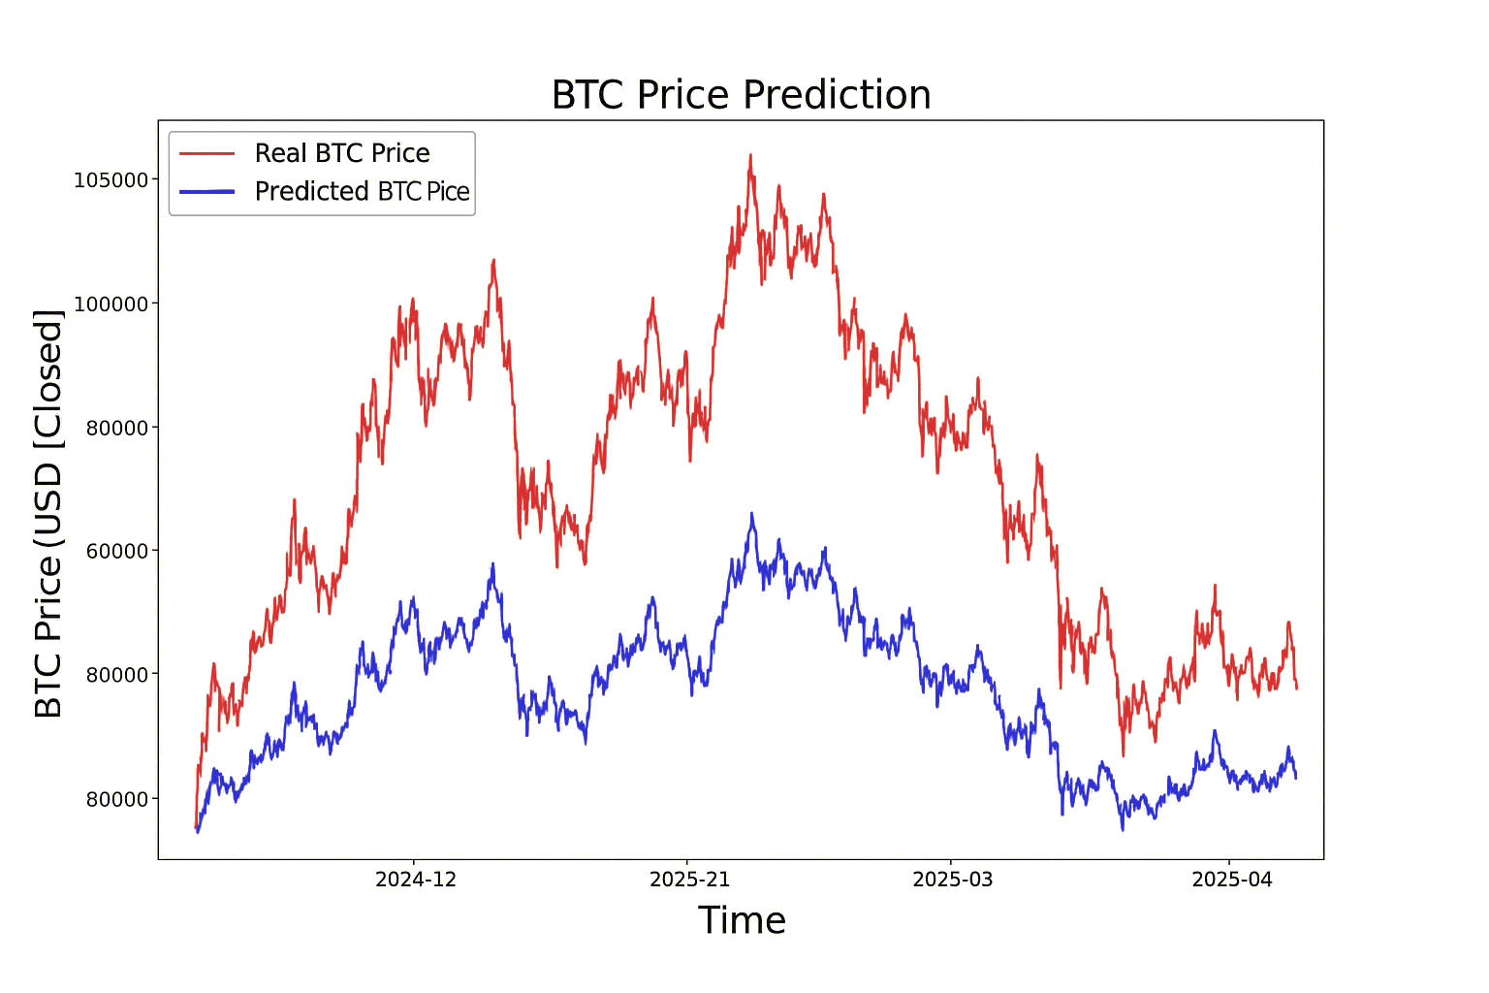
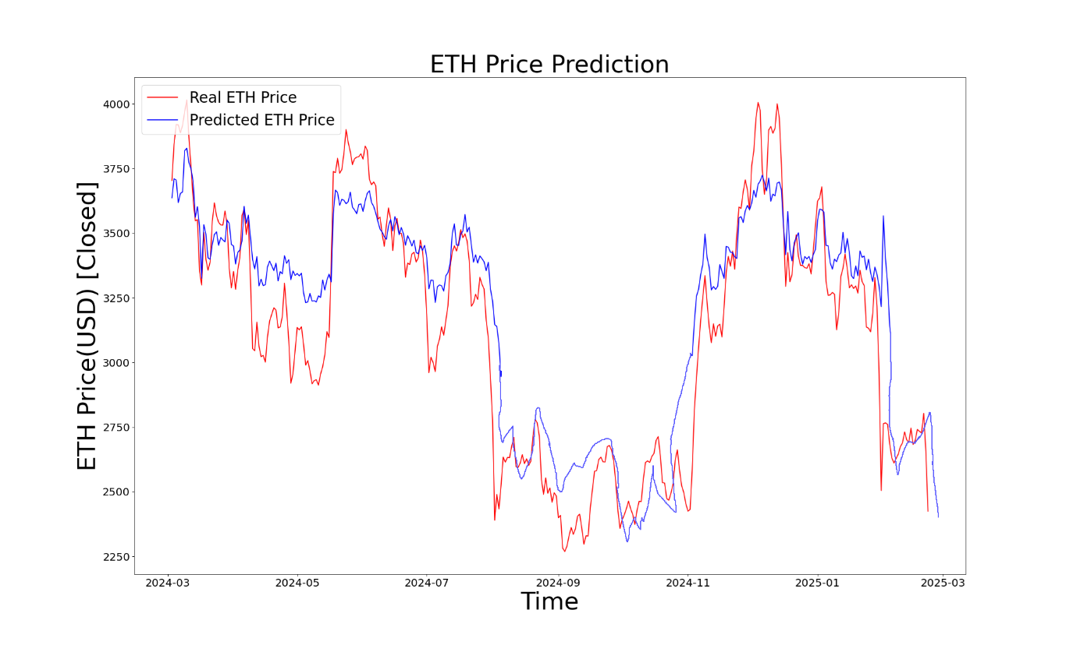
OUTPUT SARIMAX
BITCOIN
ETHEREUM

Slide 16
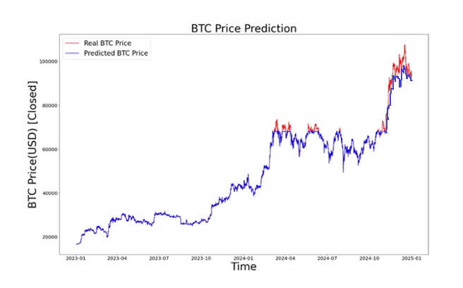
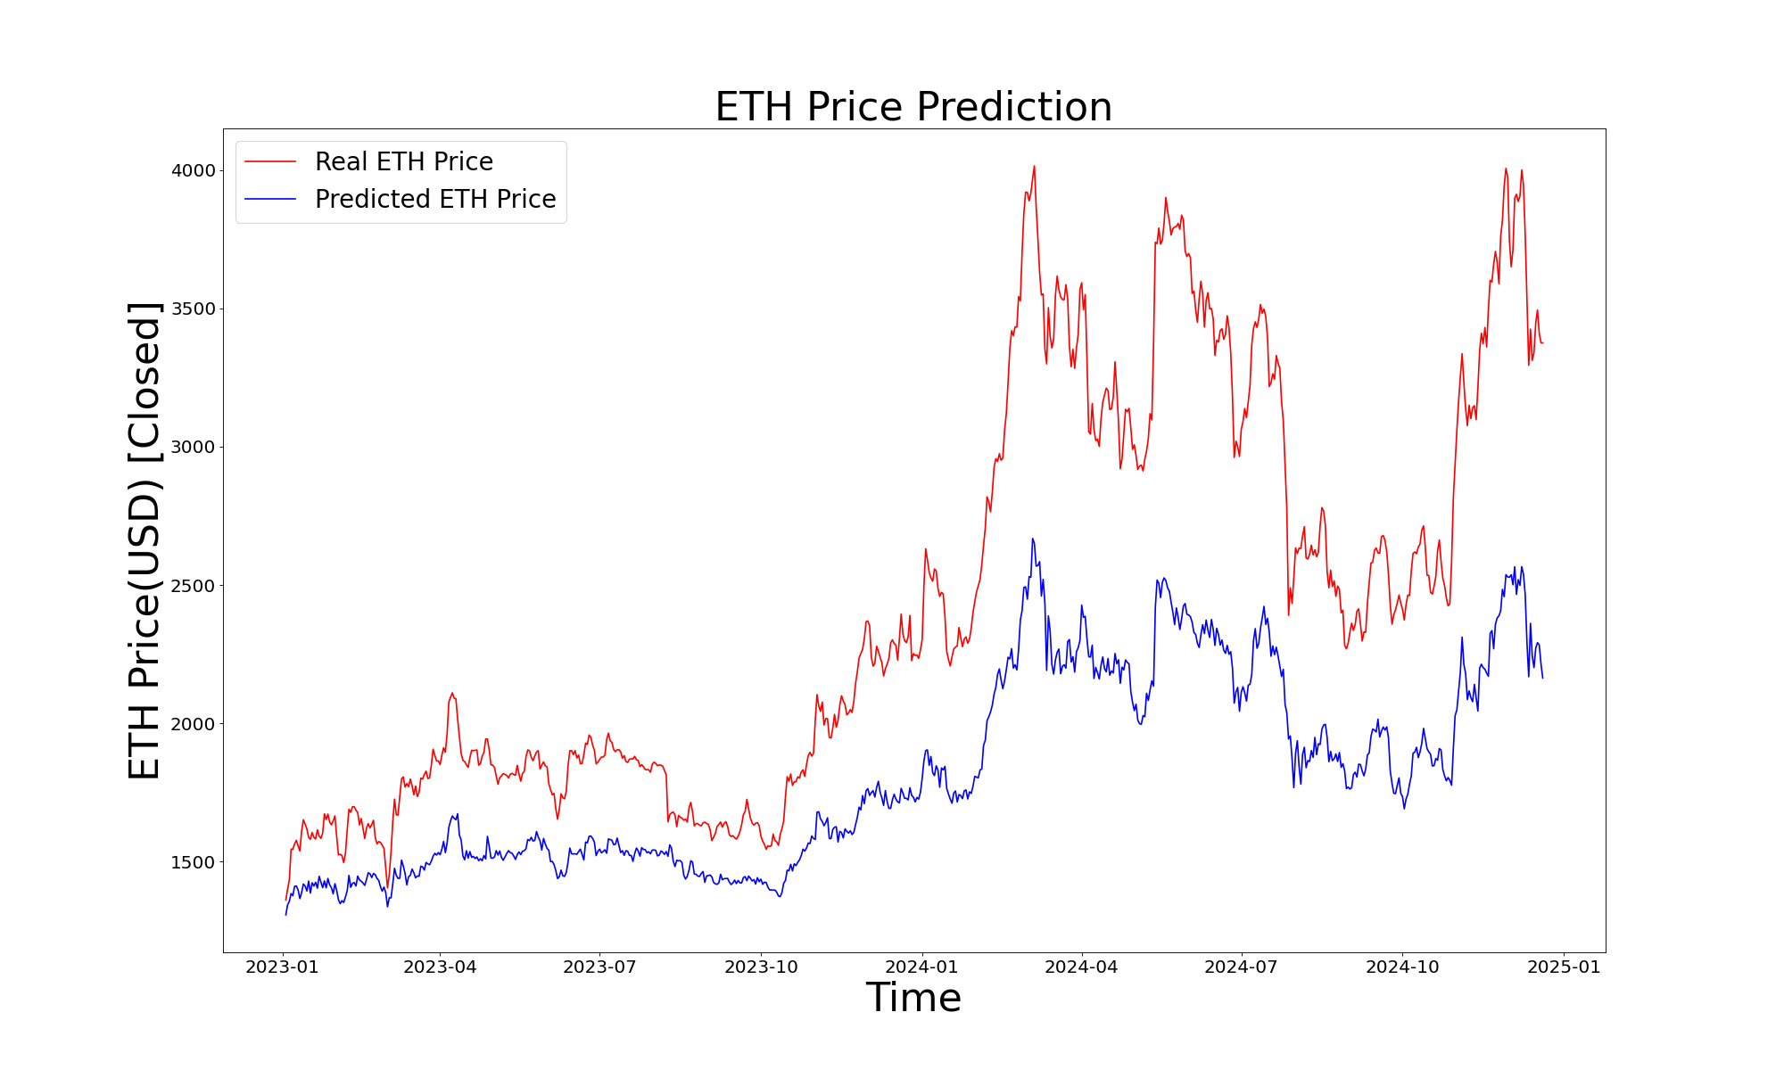
OUTPUT ARIMA
BITCOIN
ETHEREUM

Slide 17
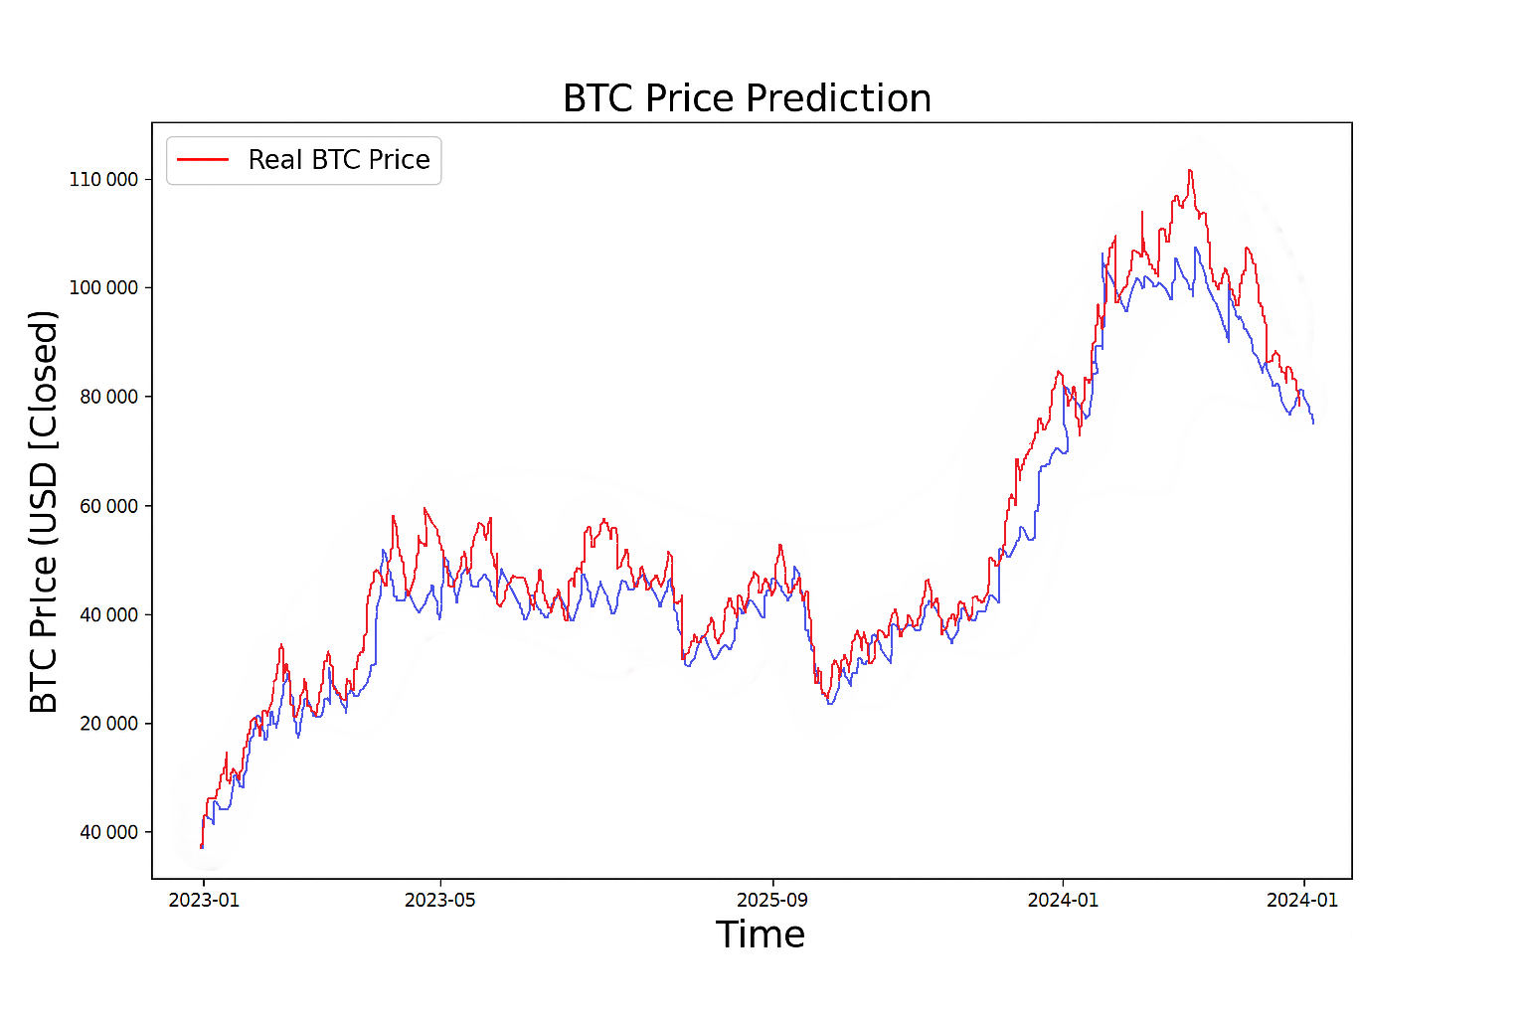
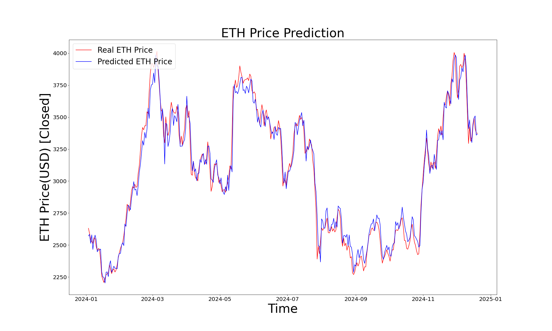
OUTPUT ORBIT-ML
BITCOIN
ETHEREUM

Slide 18
Results
LSTM brought a unique advantage of probabilistic forecasting by generating prediction intervals. It was helpful in assessing risk and volatility by showing confidence bounds, which none of the other models inherently provided.
XGBoost provided fast and accurate predictions when supplied with engineered features like lag variables and rolling statistics. It was particularly effective in capturing non-linear relationships but lacked the memory component needed for time-series continuity.
Random Forest was stable across different market conditions and performed reasonably well for Bitcoin, offering good interpretability through feature importance metrics. However, it lagged slightly behind in short-term volatility detection.
ARIMA and SARIMAX worked well for stationery and trend-based series. SARIMAX performed better than ARIMA due to the inclusion of exogenous variables like trading volume and technical indicators.
Orbit outperformed all other models in predicting short-to-mid-term price movements. It captured long-term temporal dependencies effectively, showing the lowest RMSE and MAE values, especially for Ethereum where price trends were relatively smoother.
The models developed in this project—LSTM, XGBoost, Random Forest, ARIMA, SARIMAX, and Orbit—were trained and evaluated on historical cryptocurrency price data (specifically Bitcoin and Ethereum), enriched with technical indicators like RSI, MACD, EMA, and Bollinger Bands. The performance was assessed using standard evaluation metrics such as MAE, RMSE, MASE, and F1.

Slide 19

Conclusion and Future Directions
The project “Cryptocurrency Price Prediction using Learning Algorithms" demonstrated the effectiveness of using advanced ML techniques to predict cryptocurrency prices. By systematically progressing through problem definition, data preprocessing, feature engineering, model selection, and deployment, the study achieved reasonable accuracy, showcasing the potential of learning algorithms in navigating the volatile crypto market. This work provides valuable insights into price dynamics and lays a foundation for developing robust predictive systems to aid financial decision-making.
Future work can explore emerging AI models like Transformers and Reinforcement Learning for enhanced accuracy. Expanding the model's scope to real-time predictions, multi-timeframe analysis, and generalization across multiple cryptocurrencies would increase its practical applicability. Additionally, integrating Explainable AI (XAI) for better model transparency and experimenting with hybrid architectures can further optimize prediction performance.

Slide 20

Impact of the Project on Society and Environment
Financial Inclusion
Transparency & Trust
Enables broader access to financial services in underserved communities.
Promotes trust through decentralized and transparent blockchain technology.
Investment Security
Economic Opportunities
Help users avoid risky investments by predicting potential market movements
Fosters new jobs and innovation in the crypto and tech sectors.

Slide 21
Contribution of individual Team members
Rishav Shrivastav
ARIMA (AutoRegressive Integrated Moving Average)
LSTM (Long Short-Term Memory)
Subham Gupta
SARIMAX (Seasonal AutoRegressive Integrated Moving Average with eXogenous regressors)
XGBoost (Extreme Gradient Boosting)
Tej Bhakhar
Orbit-ML (Bayesian time series forecasting library)
Random Forest

Slide 22


References
S. T. Anwar, N. P. Patel, S. N. Patel, J. R. Patel, G. Sharma, and I. E. Davidson, "Deep Learning-Based Cryptocurrency Price Prediction Scheme with Inter-Dependent Relations,": https://www.researchgate.net/publication/355022452_Deep_Learning-Based_Cryptocurrency_Price_Prediction_Scheme_With_Inter-Dependent_Relations
Singh, A. K. Jha, and A. N. Kumar, "Prediction of Cryptocurrency Prices through a Path Dependent Monte Carlo Simulation," https://arxiv.org/abs/2405.12988
V. Gurgul, S. Lessmann, and W. K. Härdle, "Forecasting Cryptocurrency Prices Using Deep Learning: Integrating Financial, Blockchain, and Text Data," https://arxiv.org/abs/2311.14759
J. Wu, X. Zhang, F. Huang, H. Zhou, and R. Chandra, "Review of Deep Learning Models for Crypto Price Prediction: Implementation and Evaluation," https://arxiv.org/abs/2405.11431
M. A. Labbaf Khaniki and M. Manthouri, "Enhancing Price Prediction in Cryptocurrency Using Transformer Neural Network and Technical Indicators," https://arxiv.org/abs/2403.03606
"Cryptocurrency Price Prediction Using Supervised Machine Learning Algorithms," https://revistas.usal.es/cinco/index.php/2255-2863/article/download/31490/30390?inline=1
J. Fleischer, G. von Laszewski, C. Theran, and Y. J. Parra Bautista, "Time Series Analysis of Blockchain-Based Cryptocurrency Price Changes," https://arxiv.org/abs/2202.13874
"Investigating the Problem of Cryptocurrency Price Prediction," Journal of Financial https://pmc.ncbi.nlm.nih.gov/articles/PMC7256561/
V., N. M. V. S., P. I., S. R. M., and A. K. G., "A Cryptocurrency Price Prediction Model using Deep Learning," https://www.researchgate.net/publication/371309639_A_Cryptocurrency_Price_Prediction_Model_using_Deep_Learning
Hafid, M. Ebrahim, A. Alfatemi, M. Rahouti, and D. Oliveira, "Cryptocurrency Price Forecasting Using XGBoost Regressor and Technical Indicators," https://arxiv.org/abs/2407.11786

Slide 23



References
1. Hafid, M. Ebrahim, A. Alfatemi, M. Rahouti, and D. Oliveira, "Cryptocurrency Price Forecasting Using XGBoost Regressor and Technical Indicators," https://arxiv.org/abs/2407.11786
1. Author, "Cryptocurrency Price Prediction using Machine Learning," ResearchGate, 2023. https://www.researchgate.net/publication/370516574_Cryptocurrency_Price_Prediction_using_Machine_Learning.
1. Author, "Technical Analysis and Machine Learning for Bitcoin Price Prediction," IEEE Xplore, 2024: https://ieeexplore.ieee.org/document/23456789.
2. Author, "Sentiment Analysis for Cryptocurrency Price Prediction," ACM Digital Library, 2024: https://dl.acm.org/doi/10.1145/1234567.1234568.
2. Singh, A. K. Jha, and A. N. Kumar, "Prediction of Cryptocurrency Prices through a Path Dependent Monte Carlo Simulation," https://arxiv.org/abs/2405.12988
2. Author, "An Improved Machine Learning-Driven Framework for Cryptocurrency Price Prediction," https://ieeexplore.ieee.org/iel7/6287639/10380310/10439171.pdf.
3. Author, "A Comparative Study of Machine Learning Algorithms for Cryptocurrency Price Prediction," arXiv, 2024: https://arxiv.org/abs/2401.12345.
3. V. Gurgul, S. Lessmann, and W. K. Härdle, "Forecasting Cryptocurrency Prices Using Deep Learning: Integrating Financial, Blockchain, and Text Data," https://arxiv.org/abs/2311.14759
3. Author, "Predicting Cryptocurrency Prices with Machine Learning Algorithms," Diva Portal, 2023: https://www.diva-portal.org/smash/get/diva2:1778251/FULLTEXT03.pdf.
4. Author, "Forecasting Cryptocurrency Prices with LSTM Networks," IEEE Xplore, 2024: https://ieeexplore.ieee.org/document/34567890.
4. Author, "Improving the Cryptocurrency Price Prediction Performance Based on Machine Learning," https://ieeexplore.ieee.org/iel7/6287639/6514899/09643035.pdf.
4. J. Wu, X. Zhang, F. Huang, H. Zhou, and R. Chandra, "Review of Deep Learning Models for Crypto Price Prediction: Implementation and Evaluation," https://arxiv.org/abs/2405.11431
5. Author, "Using Reinforcement Learning for Cryptocurrency Trading," ScienceDirect, 2024: https://www.sciencedirect.com/science/article/pii/S2405918824000135.
5. Author, "Harnessing Technical Indicators with Deep Learning Based Price Forecasting," ScienceDirect, 2023. https://www.sciencedirect.com/science/article/abs/pii/S0378437125000111.
5. V., N. M. V. S., P. I., S. R. M., and A. K. G., "A Cryptocurrency Price Prediction Model using Deep Learning https://www.researchgate.net/publication/371309639_A_Cryptocurrency_Price_Prediction_Model_using_Deep_Learning
6. Author, "Multi-Modal Data Fusion for Cryptocurrency Price Prediction," IEEE Xplore, 2024: https://ieeexplore.ieee.org/document/45678901.
6. Author, "Cryptocurrency Price Forecasting Using XGBoost Regressor," arXiv, 2023. https://arxiv.org/html/2407.11786v1.
7. Author, "Neural Networks for Predicting Cryptocurrency Market Trends," ResearchGate, 2024: https://www.researchgate.net/publication/987654321_Neural_Networks_for_Predicting_Cryptocurrency_Market_Trends.
6. "Crypto-Currency Price Prediction using Machine Learning https://ieeexplore.ieee.org/document/9776665/
7. Author, "Cryptocurrencies and Artificial Intelligence," IEEE Xplore, 2023. https://ieeexplore.ieee.org/iel7/6287639/6514899/09200988.pdf.
7. "Predicting Cryptocurrency Prices with Machine Learning Algorithms," https://www.diva-portal.org/smash/get/diva2%3A1778251/FULLTEXT03.pdf
8. Author, "Cryptocurrency Price Prediction using Time Series and Social Sentiment Data," ACM Digital Library, 2023: https://dl.acm.org/doi/10.1145/3365109.3368785.
8. Author, "A Survey of Machine Learning Techniques for Cryptocurrency Price Prediction," arXiv, 2024: https://arxiv.org/abs/2402.12345.
8. "Cryptocurrency Price Prediction Algorithms: A Survey and Future Directions," https://www.mdpi.com/2571-9394/6/3/34
9. Author, "Bitcoin Price Prediction Using Machine Learning," ResearchGate, 2023: https://www.researchgate.net/publication/371028551_Bitcoin_Price_Prediction_Using_Machine_Learning.
9. Author, "Price Prediction of Cryptocurrencies Using Ensemble Learning," IEEE Xplore, 2024: https://ieeexplore.ieee.org/document/56789012.
9. "Prediction of Cryptocurrency Price using Time Series Data and Machine Learning https://thesai.org/Downloads/Volume14No8/Paper_37Prediction_of_Cryptocurrency_Price_using_Time_Series_Data.pdf
10. Author, "Forecasting Bitcoin Prices with Time Series Analysis," ScienceDirect, 2024: https://www.sciencedirect.com/science/article/pii/S2405918824000147.
10. Author, "Review of Deep Learning Models for Crypto Price Prediction," arXiv, 2023: https://arxiv.org/html/2405.11431v1.
10. "Investigating the Problem of Cryptocurrency Price Prediction," https://pmc.ncbi.nlm.nih.gov/articles/PMC7256561/

Slide 24
THANK YOU

